Slide 1



CORPORATE CREDIT CARD MISUSE DETECTION USING MACHINE LEARNING AND ETL PIPELINE
CS6140 — FINAL PROJECT
Name: Pooja Malakappa Nuchchi
Date: April 2026

Slide 2

WHY THIS MATTERS
5% of revenue lost to fraud annually
284,807 transactions — only 0.17% are fraud
Manual review? Not scalable.
Arrow pointing to: Solution: ML-powered automated detection
01

Slide 3
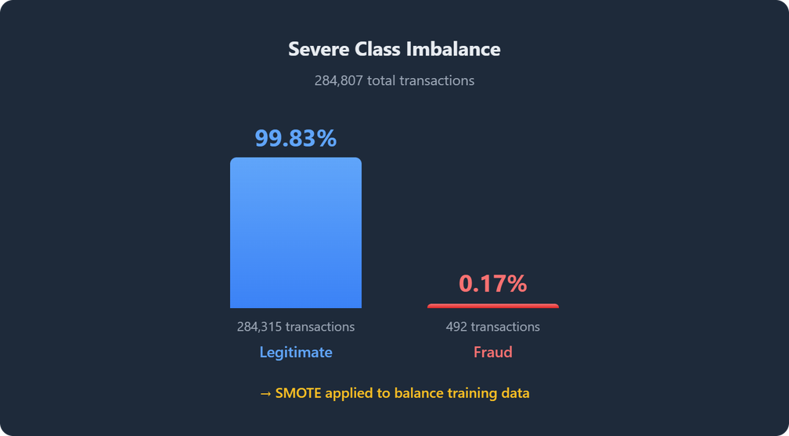
ABOUT THE DATA
Dataset: Credit Card Fraud Detection (ULB, Kaggle)
284,807 transactions
30 features: V1–V28 (PCA), Amount_Scaled, Hour
Class imbalance visual: big blue bar (99.83% legit) vs tiny red bar (0.17% fraud)
SMOTE applied to balance training data
02

Slide 4

End-to-End Pipeline
Components to list:
ETL Pipeline: Python scripts → PostgreSQL
ML Training: 5 models with SMOTE
Backend: FastAPI with 7 endpoints
Frontend: React dashboard with 4 pages
03

Slide 5
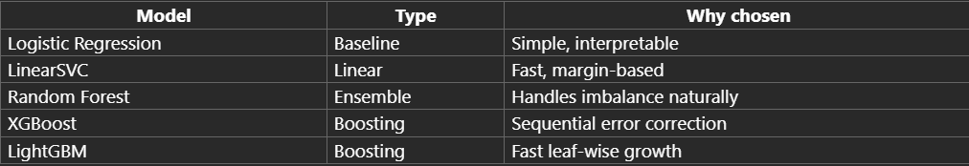
Model Selection
04

Slide 6

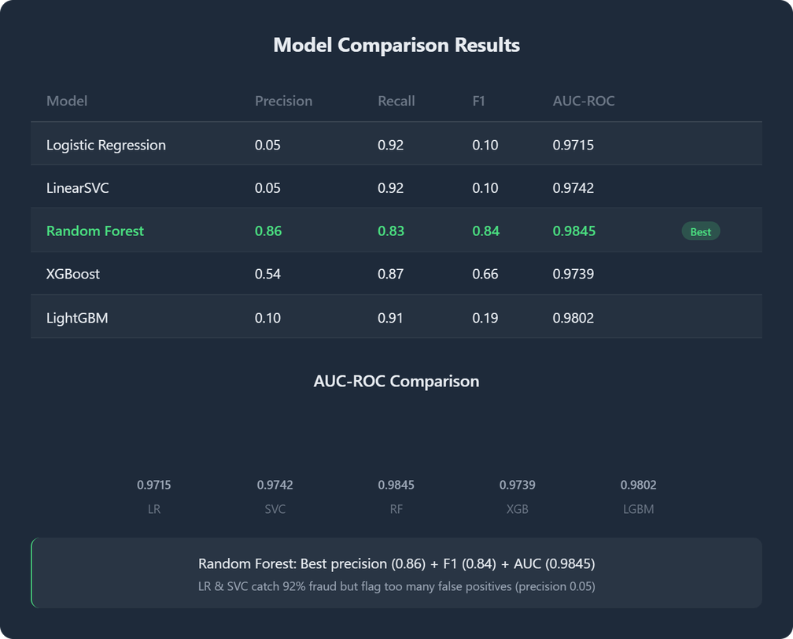
RESULTS & ANALYSIS
Key insight: Random Forest wins best precision (0.86), F1 (0.84), and AUC (0.9845)
05

Slide 7
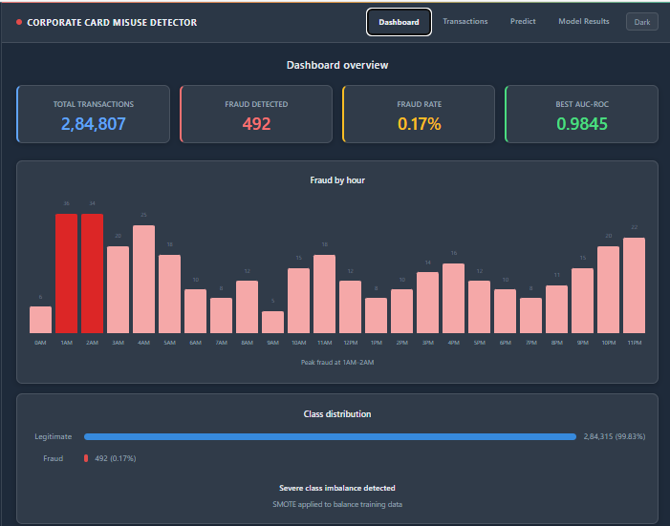
Output Screenshots
Dashboard
06

Slide 8
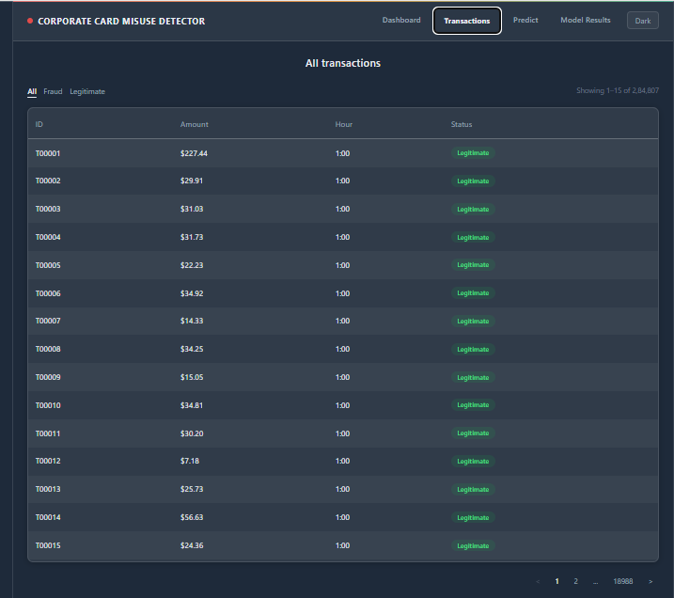
Transactions
07

Slide 9
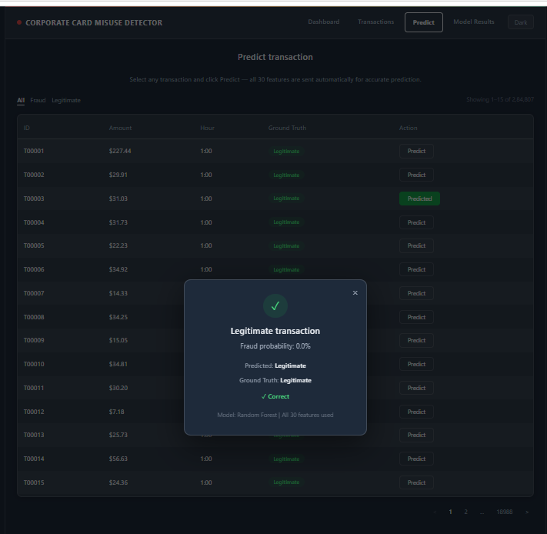
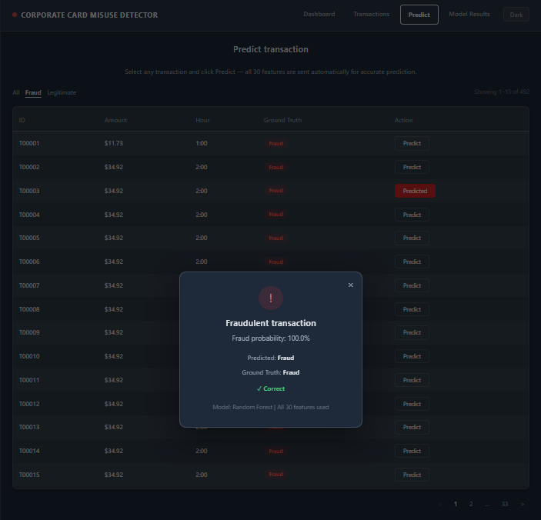
Predict-legitimate case
Predict- fraud case
08

Slide 10
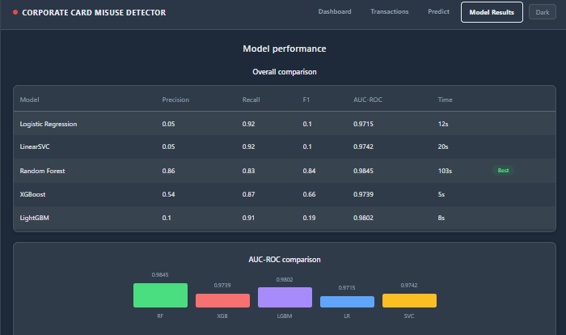
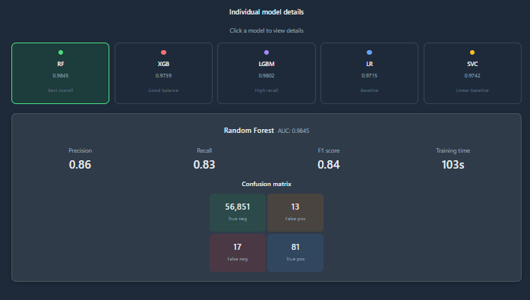
Model Results
09

Slide 11
Limitations & Next Steps
Limitations:
Dataset uses anonymized PCA features — can't interpret what V1–V28 represent
Amount and Hour alone can't detect fraud — V features carry the signal
No real-time streaming
Future work:
Real-time streaming with Apache Kafka
Airflow for scheduled pipeline orchestration
Allowing user input
07

Slide 12

GitHub:
github.com/pooja-malakappa-nuchchi/corp-card-fraud-pipeline
https://github.com/pooja-malakappa-nuchchi/corp-card-fraud-pipeline/tree/pooja
Tech Stack: Python, PostgreSQL, FastAPI, React, scikit-learn, XGBoost, LightGBM
"Questions? Post in the discussion thread!"
08

